Slide 1
Generalized Overlapping Group Lasso for Patients Subgroups Selection
Wenxuan Deng

Slide 2
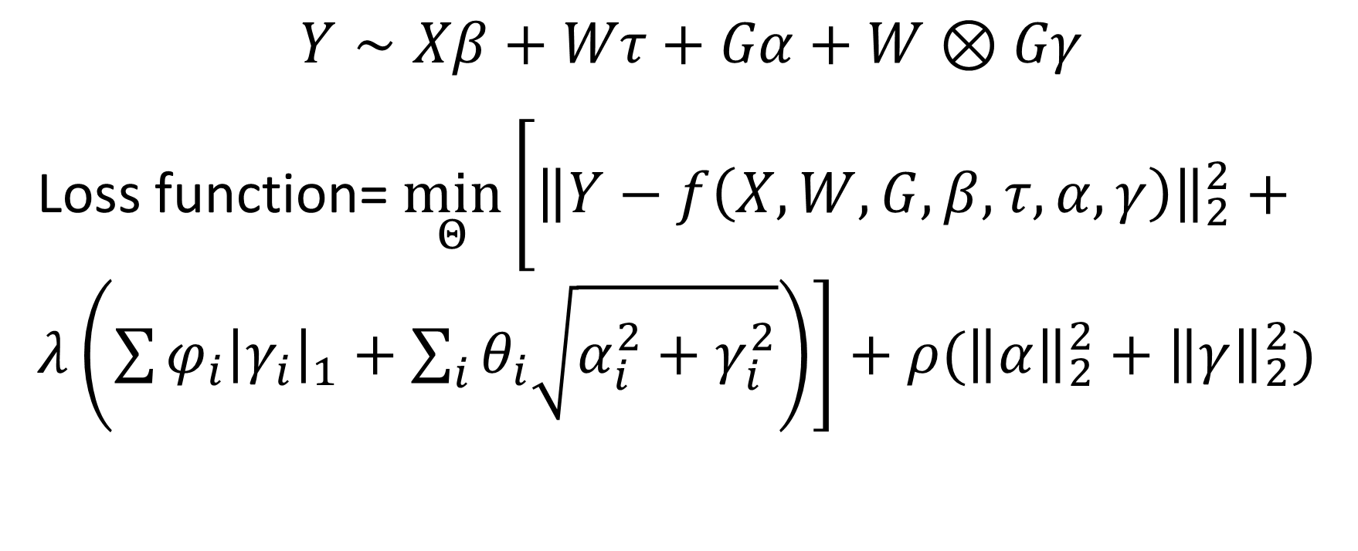
Model
Baseline Variable
Treatment Variable
Main/Interaction Effects of Genes
$$Y∼Xβ+Wτ+Gα+W⊗Gγ$$
Loss function= $\min_{Θ}\left[{\left\|Y−f\left(X,W,G,β,τ,α,γ\right)\right\|}_{2}^{2}+λ\left(\sum{φ_{i}{\left|γ_{i}\right|}_{1}}+\sum_{i}{θ_{i}\sqrt{α_{i}^{2}+γ_{i}^{2}}}\right)\right]+ρ({\left\|α\right\|}_{2}^{2}+{\left\|γ\right\|}_{2}^{2})$

Slide 3
Simulation Setup
N=100
Dimensions for baseline variables = 5
Dimensions for treatment variable = 1, (binary: +1,-1)
Dimensions for Genes = 100
10% genes are both predictive and prognostic
10% of genes are only prognostic
8% of genes are only predictive
Nonzero coefficients are randomly sampled from +1,-1,+3,-3

Slide 4

Signal/Noise ratio
$SNR=\frac{var(y_{0})}{var(ε)}$, where $y=y_{0}+ε$
SNR=10

